Slide 1



AI Chat Summarizer
A Containerized NLP Application Final Project Presentation
Hassan Muhammad
Student ID 20243120101
Notes:
1

Slide 2
Project Objective
The goal was to build a working machine learning application that uses deep learning for an NLP task. It had to be fully containerized using Docker.
My project does this by creating a system that:
Summarizes long chat or text using a transformer model.
Saves those summaries with their meaning (embeddings) to a searchable database.
Lets you find past summaries by meaning, not just keywords.
Runs everything in separate, connected Docker containers.
Notes:
2

Slide 3
System Architecture
The application is split into three services, managed by Docker Compose.
Backend Service (FastAPI)
Frontend Service (Gradio UI)
Proxy Service (Nginx)
Contains the AI models for summarization and embedding.
Acts as a traffic manager for the services (optional but good practice).
Provides a simple web interface with two tabs: one for summarizing, one for searching.
Handles the logic: processing text, generating summaries, and talking to the database.
Runs on port 9003.
Talks to the backend to get results.
Runs on port 9001.
Runs on port 9002.
A volume stores the vector database data permanently, so it isn't lost when the containers restart.
Notes:
3

Slide 4
Meeting the Core Requirements
Here is how my implementation matches the main project requirements.
Use a Deep Learning Model
Used Hugging Face's transformers pipeline with a DistilBART model for summarization.
Implement Semantic Search
Used the sentence-transformers model to create embeddings and stored/queried them in ChromaDB.
Data Preprocessing
Wrote a preprocess() function to clean whitespace and validate input length (min 50 chars).
Vector Database
Integrated ChromaDB in persistent mode to store and retrieve summary embeddings.
Application Interface
Built a clean, two-tab interface using Gradio for user input and display.
Containerization
Created separate Dockerfiles for backend and frontend.
Docker Compose
Used docker-compose.yml to define and link the three services (backend, frontend, nginx).
Notes:
4

Slide 5
The Machine Learning Pipeline
This is the step-by-step logic inside the backend when a user submits text.
01
02
Receive & Clean Text
Validate Length
The input text is cleaned of extra spaces.
It checks if the text is at least 50 characters long.
03
04
Generate Summary
Create an Embedding
The tiny DistilBART model creates a short summary.
The SentenceTransformer model converts the summary into a numerical vector (embedding) that represents its meaning.
05
06
Store to Database
Return Result
The summary text, its embedding vector, and a snippet of the original text are saved together in ChromaDB with a unique ID.
The summary and its ID are sent back to the user.
Notes:
5

Slide 6




Semantic Search in Action
When a user types a search query, here is what happens:
Query to Vector
The search query is converted into an embedding vector using the same model.
Compare Vectors
ChromaDB compares this query vector to all the summary vectors it has stored.
Find Similar Summaries
It finds the 3 most similar summaries based on vector "distance" (similarity score).
Display Results
These results, along with their similarity scores, are sent back and displayed in the Gradio interface.
This allows users to find summaries about "customer complaints" or "project deadlines" even if those exact words aren't in the saved text.
Notes:
6

Slide 7
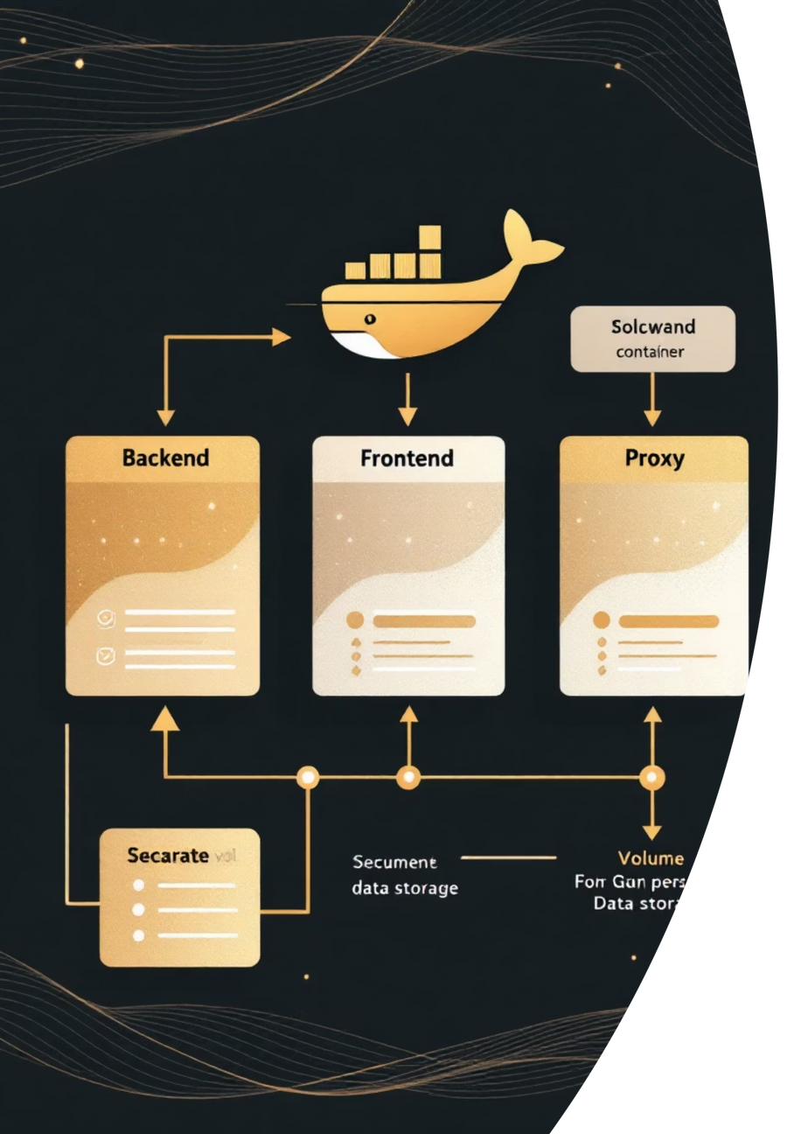
Dockerization Strategy
Containers make the application reliable and portable.
Backend Dockerfile: Starts from a Python slim image. It uses a specific trick to install PyTorch for CPU from the official source and all other packages (like ChromaDB, transformers) from the Aliyun mirror in China for faster, reliable builds.
Frontend Dockerfile: A simpler setup that installs Gradio and requests.
Docker Compose: This is the key file. It defines all three services, sets their build paths, maps the host ports (9001, 9002, 9003) to the container ports, creates shared volumes for the model cache and database, and defines the startup order.
Notes:
7

Slide 8
Code Highlights
Here are some key pieces of my code that show the core functionality.
Loading Models Efficiently (Backend):
FastAPI Endpoints (Backend):
Gradio UI (Frontend):
Built a clean interface with gr.Blocks(). It has two tabs connected to Python functions that call the backend API, handle errors, and format the results for display.
I used global variables and a get_models() function. This ensures the large AI models and the database connection are loaded only once when the server starts, not on every request.
Created two main endpoints:
POST /summarize: Takes text, runs the full ML pipeline, stores the result.
POST /search: Takes a query, finds similar summaries.
Notes:
8

Slide 9

Challenges and Solutions
I faced a couple of practical problems and here is how I solved them.
1
2
3
Challenge 1: Large Model Downloads in Docker.
Challenge 2: Docker Build Failures with PyTorch.
Challenge 3: Connecting Frontend to Backend.
Problem: The standard Hugging Face models are huge and can fail to download inside a Docker build in China.
Problem: PyTorch has complex dependencies that conflict with some mirrors.
Problem: The frontend container needs to find the backend container's IP address.
Solution: In the backend Dockerfile, I installed PyTorch separately first using its official CPU-only index URL, then installed the rest of the requirements from the Aliyun mirror. This made the build fast and stable.
Solution: With Docker Compose, you can use the service name as a hostname. I set the API_URL in the frontend code to "http://backend:8000", and Docker's internal network handles the connection.
Solution: I used a very small model (sshleifer/tiny-distilbart-cnn-12-6, ~30MB) for the summarizer to demonstrate the pipeline. For the embedding model, I relied on the Aliyun mirror for the sentence-transformers library.
Notes:
9

Slide 10
Conclusion and Demo
Summary: I successfully built a containerized NLP application that performs text summarization and semantic search. It uses transformer models, a vector database, a Gradio UI, and is fully deployed with Docker Compose, meeting all the project's technical requirements.
Future Work:
Use a larger, more powerful summarization model.
Add user authentication and separate summary histories.
Deploy the Docker containers to a cloud server.
Live Demo:
[This is where you would show your application running. You could show screenshots of:]
The terminal running docker-compose up.
The Gradio interface in a browser.
Summarizing a paragraph of text.
Searching for a related concept in past summaries.
Notes:
10

